Slide 1
Cascading Style Sheet
What is CSS?
- CSS stands for Cascading Style Sheets
- CSS is the language we use to style an HTML document.
- CSS describes how HTML elements should be displayed on screen, paper, or in other media.
- CSS saves a lot of work. It can control the layout of multiple web pages all at once
- External stylesheets are stored in CSS files

Slide 2
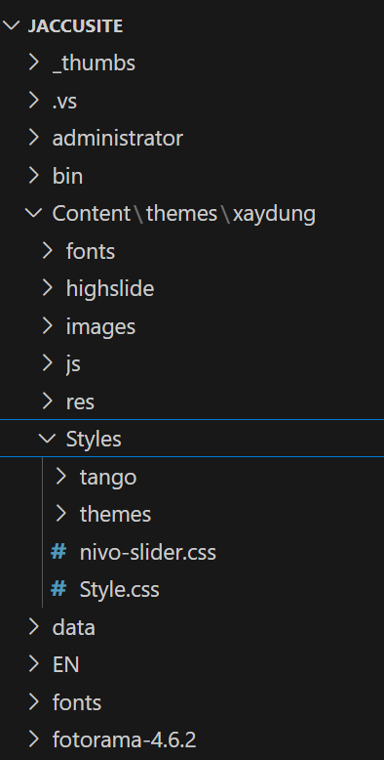
Where to place CSS file?
CSS file can put in any folder of project and the folder should contain only static files
1
E.g: /Content/css/style.css
2
E.g: /Themes/Content/css/style.css
3
3
E.g: /Resource/….

Slide 3
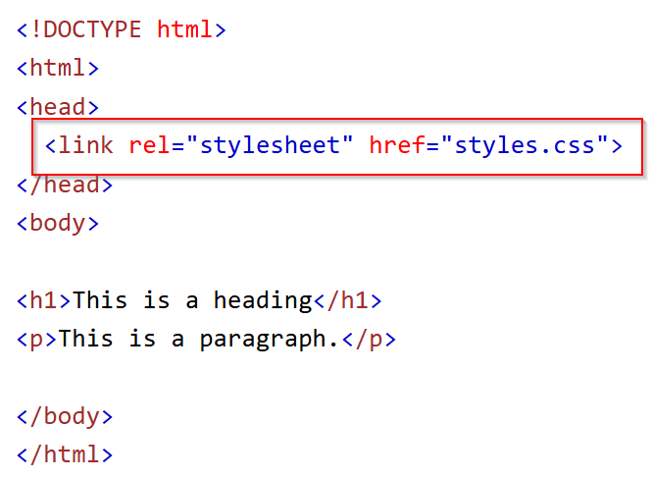
How to link a CSS file?
Question: Three Ways to Insert CSS?
1
We can link multi CSS files on a html page
2
The priority of files are bottom to top.
(It mean the style in a file can overwrite the style in above files)
3

Slide 4
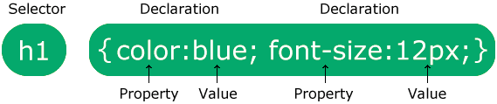
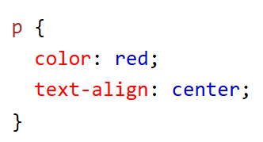
CSS syntax
1
Selector
2
Declaration
Property
Value
Separated by a colon
3
3
Multiple CSS declarations are separated with semicolons, and declaration blocks are surrounded by curly braces.

Slide 5
CSS selector
1
Simple selectors (select elements based on name, id, class)
2
Combinator selectors (select elements based on a specific relationship between them)
3
3
Pseudo-class selectors (select elements based on a certain state)
3
4
Pseudo-elements selectors (select and style a part of an element)
3
5
Attribute selectors (select elements based on an attribute or attribute value)
3

Slide 6
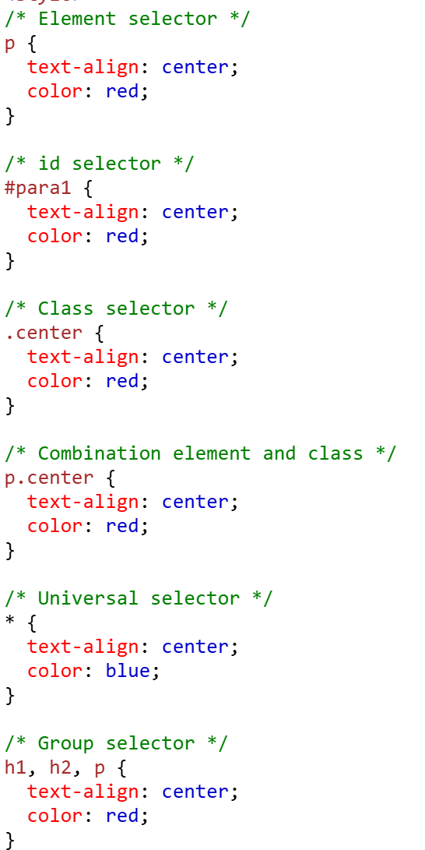
CSS selector
1
Simple selectors (select elements based on name, id, class)
Element selector
Id selector
Class selector
Universal selector
Grouping selector

Slide 7
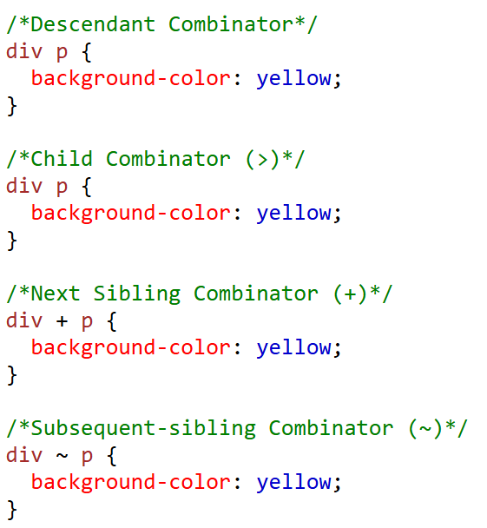
CSS selector
2
Combinator selectors (select elements based on a specific relationship between them)
Descendant combinator (space)
Child combinator (>)
Next sibling combinator (+)
Subsequent-sibling combinator (~)
3
https://www.w3schools.com/css/css_combinators.asp

Slide 8
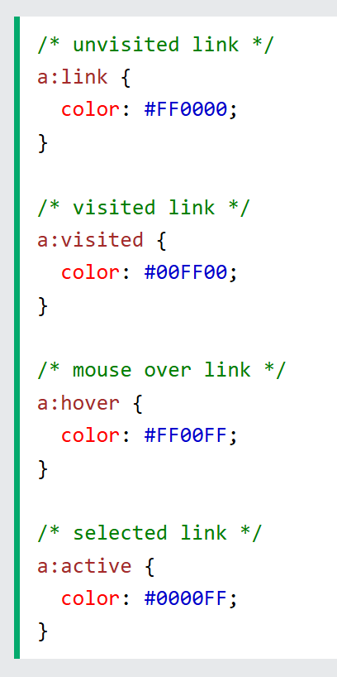
CSS selector
3
Pseudo-class selectors (select elements based on a certain state)
3
What are Pseudo-classes?
A pseudo-class is used to define a special state of an element.
For example, it can be used to:
Style an element when a user moves the mouse over it
Style visited and unvisited links differently
Style an element when it gets focus
Style valid/invalid/required/optional form elements

Slide 9
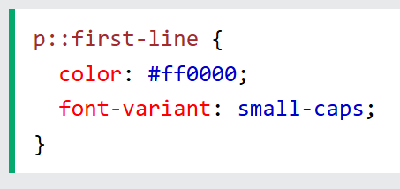
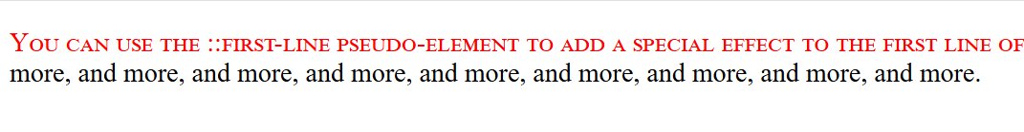
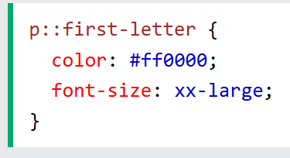
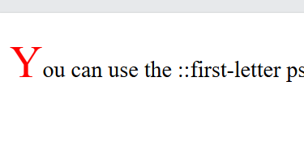
CSS selector
4
Pseudo-elements selectors (select and style a part of an element)
3
A CSS pseudo-element is used to style specific parts of an element.
::first-line: used to add a special style to the first line of a text
::first-letter: used to add a special style to the first letter of a text
::before: insert some content before the content of an element
::after: insert some content after the content of an element
::marker: selects the markers of list items.
::selection: matches the portion of an element that is selected by a user

Slide 10
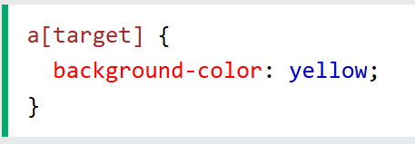
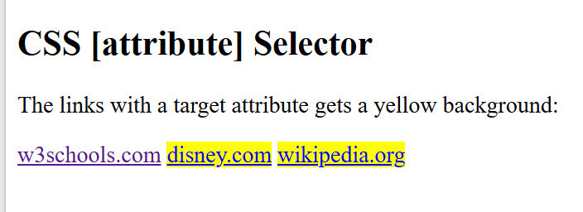
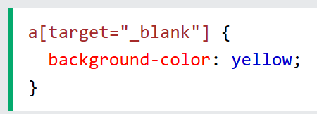
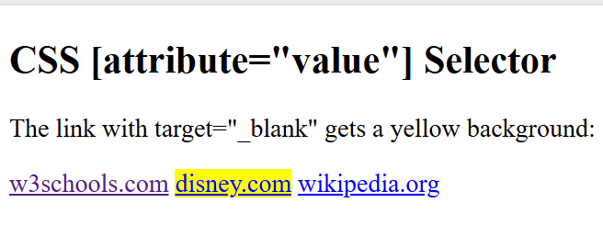
CSS selector
5
Attribute selectors (select elements based on an attribute or attribute value)
3
The [attribute] selector is used to select elements with a specified attribute.
The [attribute="value"] selector is used to select elements with a specified attribute and value.

Slide 11
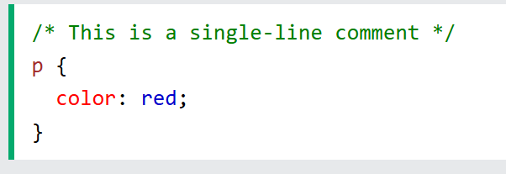
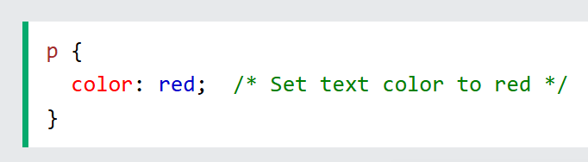
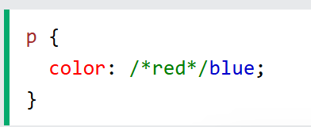
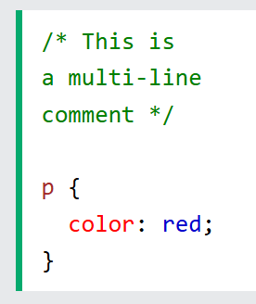
Comment
Comments are used to explain the code, and may help when you edit the source code at a later date.
Comments are ignored by browsers.

Slide 12
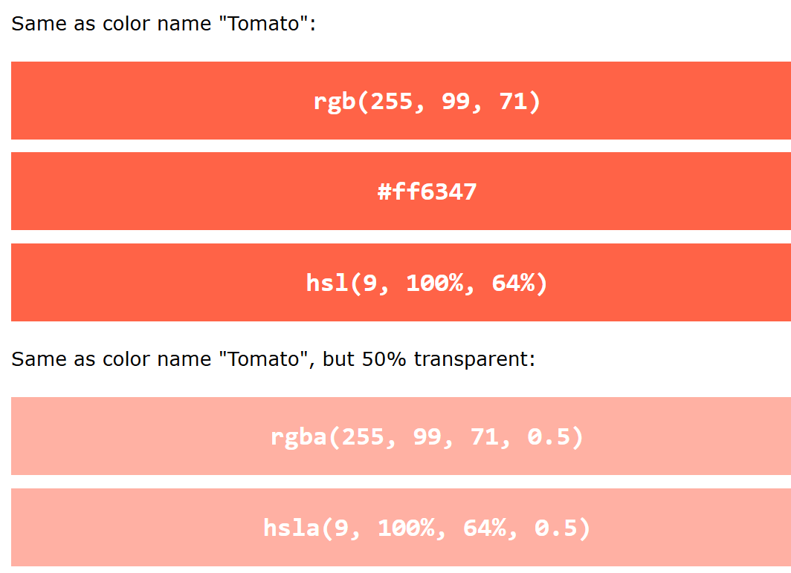
Color
Colors are specified using predefined color names, or RGB, HEX, HSL, RGBA, HSLA values.
Background Color
Text Color
Border Color
Color value

Slide 13
Background
The CSS background properties are used to add background effects for elements.
background-color
background-image
background-repeat
background-attachment
background-position
background (shorthand property)

Slide 14
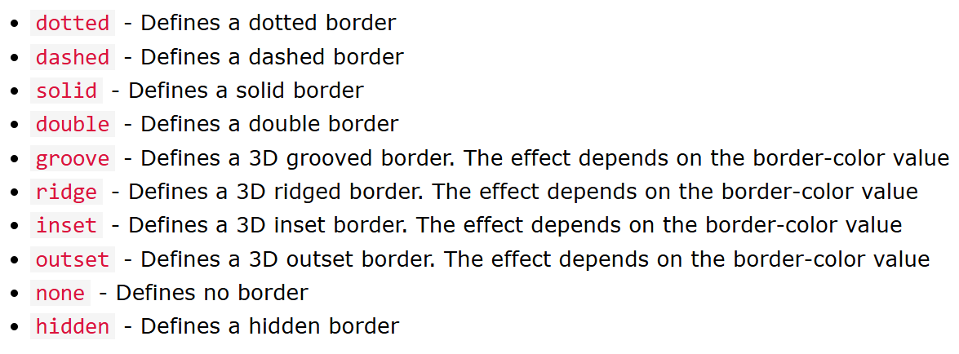
Border
The CSS border properties allow you to specify the style, width, and color of an element's border.

Slide 15
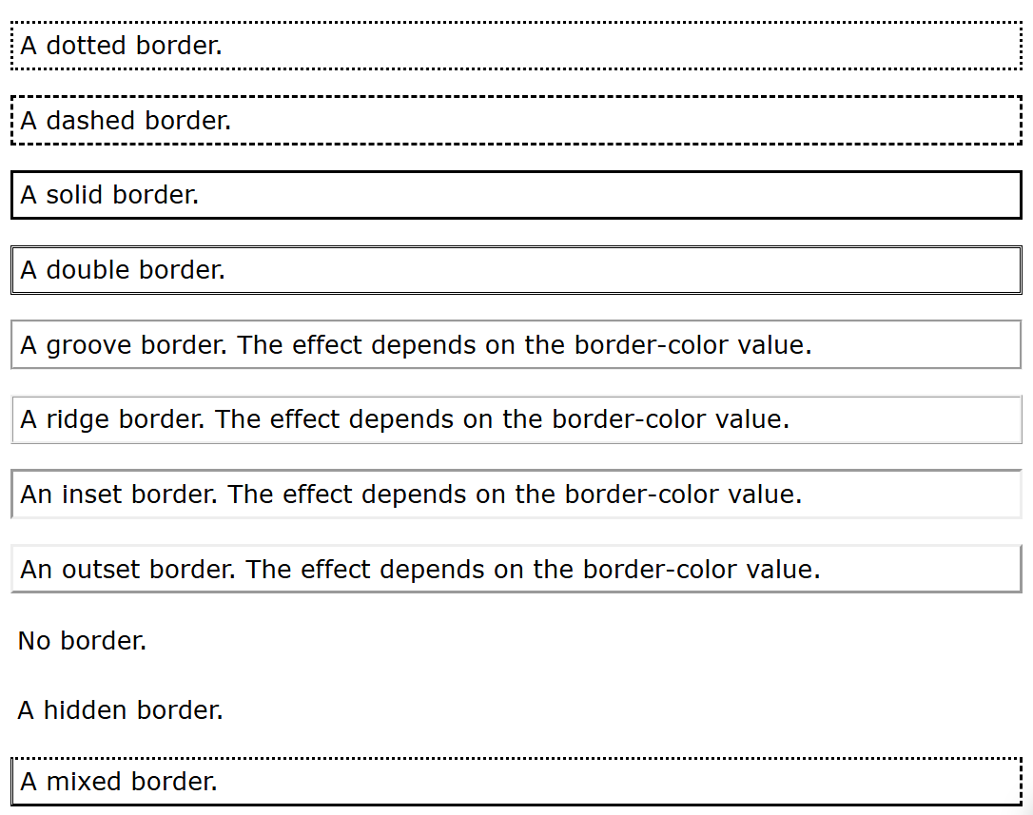
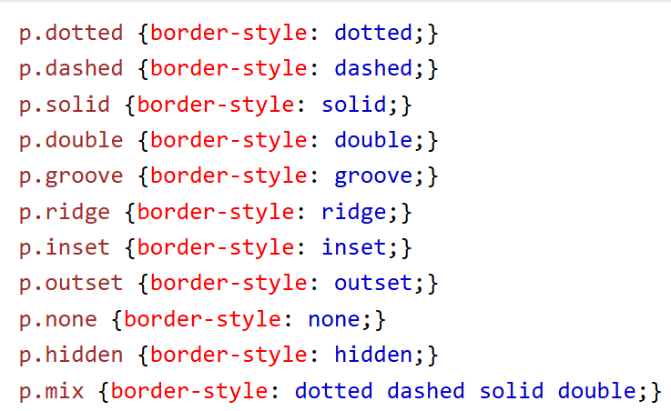
Border

Slide 16
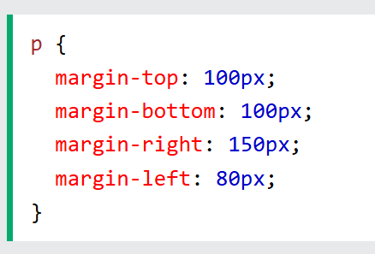
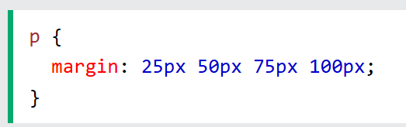
Margin
The CSS margin properties are used to create space around elements, outside of any defined borders.
top margin is 25px
right margin is 50px
bottom margin is 75px
left margin is 100px

Slide 17
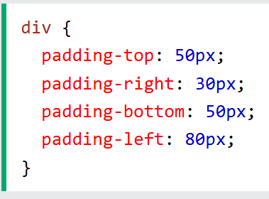
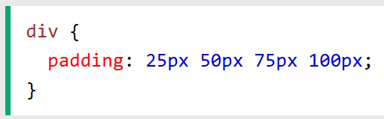
Padding
Padding is used to create space around an element's content, inside of any defined borders.

Slide 18
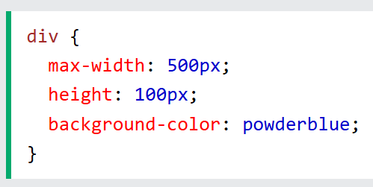
Height, Width, Max-width
The CSS height and width properties are used to set the height and width of an element.
The height and width properties may have the following values:
auto - This is default. The browser calculates the height and width
length - Defines the height/width in px, cm, etc.
% - Defines the height/width in percent of the containing block
initial - Sets the height/width to its default value
inherit - The height/width will be inherited from its parent value
The CSS max-width property is used to set the maximum width of an element.

Slide 19
Position
The position property specifies the type of positioning method used for an element.
Static: Static positioned elements are not affected by the top, bottom, left, and right properties.
Relative: Setting the top, right, bottom, and left properties of a relatively-positioned element will cause it to be adjusted away from its normal position.
Fixed: An element with position: fixed; is positioned relative to the viewport, which means it always stays in the same place even if the page is scrolled
Absolute: is positioned relative to the nearest positioned ancestor (instead of positioned relative to the viewport, like fixed). Note: Absolute positioned elements are removed from the normal flow, and can overlap elements.
Sticky: An element with position: sticky; is positioned based on the user's scroll position
Eg: https://www.w3schools.com/css/css_positioning.asp

Slide 20
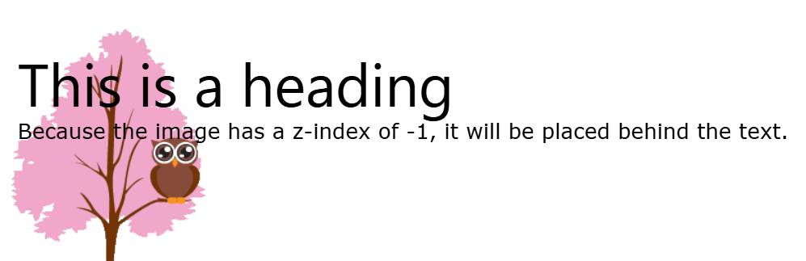
Z-index
When elements are positioned, they can overlap other elements.
The z-index property specifies the stack order of an element (which element should be placed in front of, or behind, the others).
https://www.w3schools.com/css/css_z-index.asp

Slide 21
Overflow
The overflow property specifies whether to clip the content or to add scrollbars when the content of an element is too big to fit in the specified area.
The overflow property has the following values:
visible - Default. The overflow is not clipped. The content renders outside the element's box
hidden - The overflow is clipped, and the rest of the content will be invisible
scroll - The overflow is clipped, and a scrollbar is added to see the rest of the content
auto - Similar to scroll, but it adds scrollbars only when necessary

Slide 22
Display
The display property is used to specify how an element is shown on a web page.
Every HTML element has a default display value, depending on what type of element it is. The default display value for most elements is block or inline.
The display property is used to change the default display behavior of HTML elements.
Refer: https://www.w3schools.com/css/css_display_visibility.asp

Slide 23
Javascript
JavaScript is the world's most popular programming language.
JavaScript is the programming language of the Web.
JavaScript is easy to learn.

Slide 24
Commonly Asked Questions
How do I get JavaScript?
Where can I download JavaScript?
Is JavaScript Free?

Slide 25
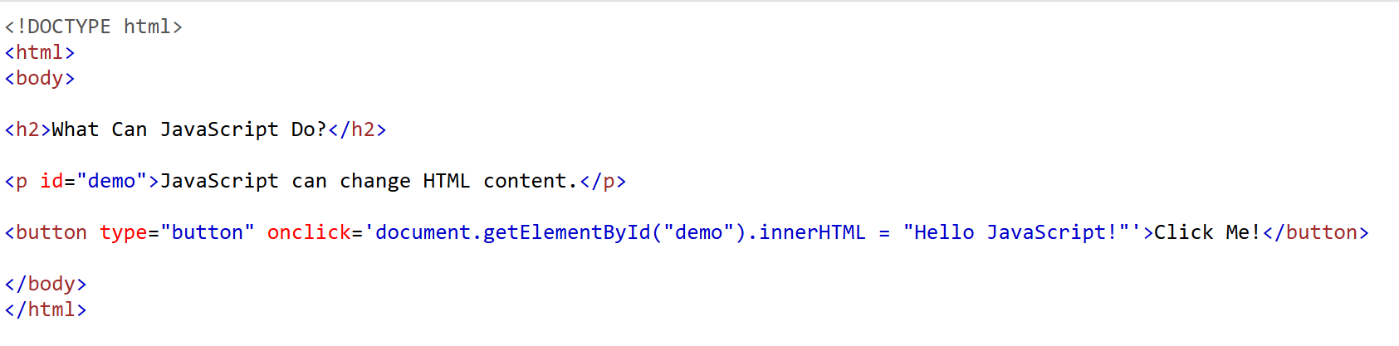
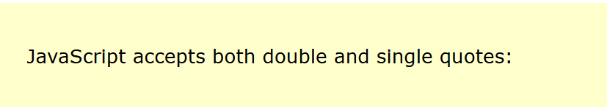
JavaScript Can Change HTML Content

Slide 26



JavaScript Can Change HTML Attribute Values (e.g <img src=’url’/>)
JavaScript Can Change HTML Styles (CSS)
JavaScript Can Hide HTML Elements
JavaScript Can Show HTML Elements

Slide 27
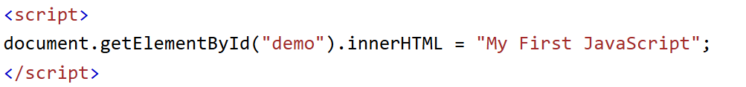
Where
JavaScript code is inserted between <script> and </script> tags
Scripts can be placed in the <body>, or in the <head> section of an HTML page, or in both.

Slide 28

External JavaScript
Scripts can also be placed in external files

Slide 29
External JavaScript Advantages
Placing scripts in external files has some advantages:
It separates HTML and code
It makes HTML and JavaScript easier to read and maintain
Cached JavaScript files can speed up page loads

Slide 30

External JavaScript

Slide 31
Variables
Variables are Containers for Storing Data
JavaScript Variables can be declared in 4 ways:
Automatically : x = 5;
Using var : var x = 5;
Using let : let x = 5;
Using const: const x= 5;

Slide 32
Variables
When to Use var, let, or const?
1. Always declare variables
2. Always use const if the value should not be changed
3. Always use const if the type should not be changed (Arrays and Objects)
4. Only use let if you can't use const
5. Only use var if you MUST support old browsers.

Slide 33
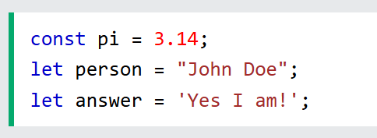
Variables
JavaScript variables can hold numbers like 100 and text values like "John Doe".
One Statement, Many Variables

Slide 34
Operators
The Assignment Operator = assigns values
The Addition Operator + adds values
The Multiplication Operator * multiplies values
The Comparison Operator > compares values
The Division Operator / compares values
The Modulus Operator % compares values
Increment ++, Decrement --

Slide 35
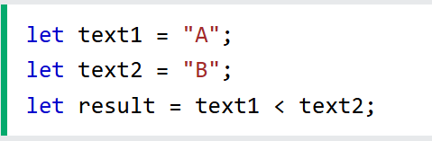
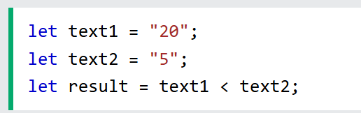
String comparison
In javascript, strings are compared alphabetically

Slide 36
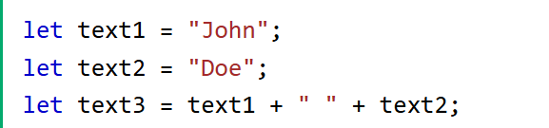

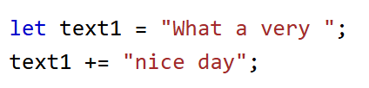

String Addition

Slide 37
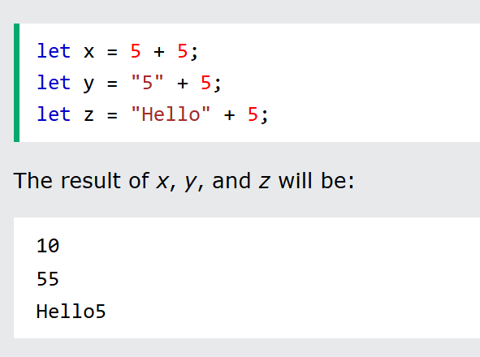
Adding Strings and Numbers

Slide 38
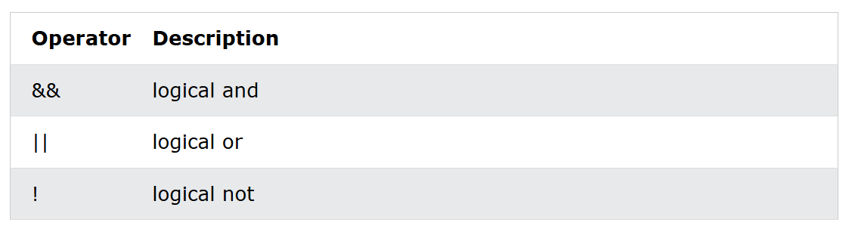
Logical Operators
if(A && B){ console.log(“ressult”);}
if(A || B){ console.log(“ressult”);}
if(!A){ console.log(“ressult”);}

Slide 39
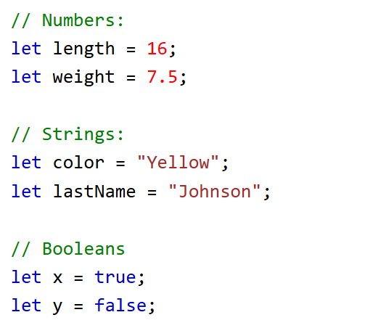
Data Types
JavaScript has 8 Datatypes
String
Number
Bigint
Boolean
Undefined
Null
Symbol
Object

Slide 40
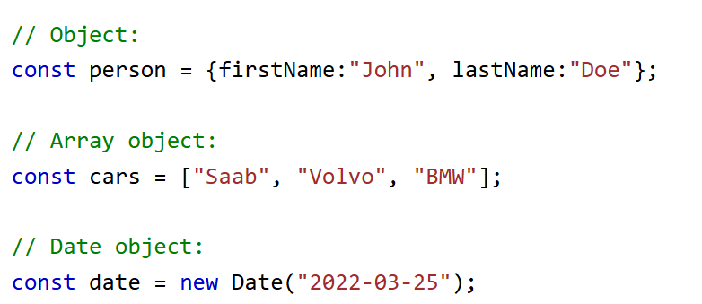
Object Datatype
The object data type can contain both built-in objects, and user defined objects:
Built-in object types can be:
objects, arrays, dates, maps, sets, intarrays, floatarrays, promises, and more.

Slide 41
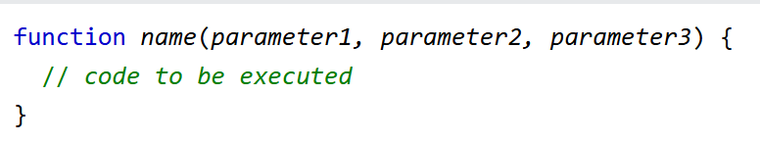
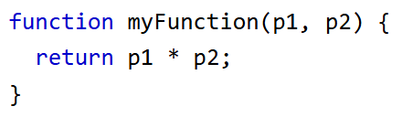
Functions
A JavaScript function is a block of code designed to perform a particular task.
A JavaScript function is executed when "something" invokes it (calls it).

Slide 42
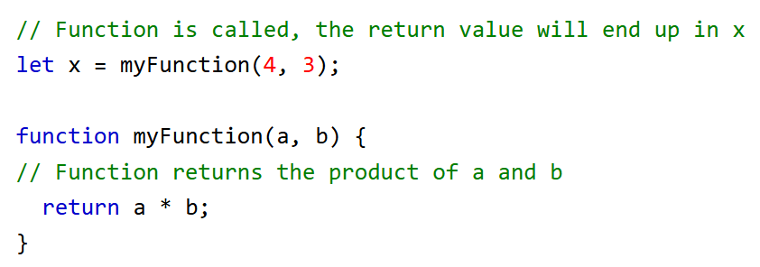
Function return
Why Functions?
With functions you can reuse code
You can write code that can be used many times.
You can use the same code with different arguments, to produce different results.

Slide 43
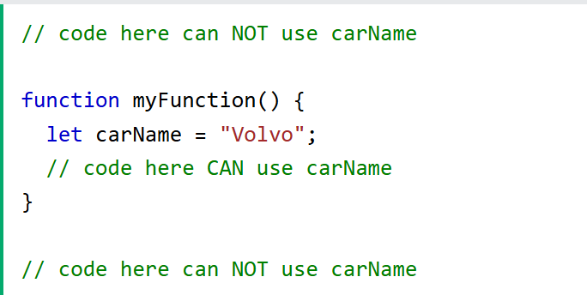
Local variables

Slide 44
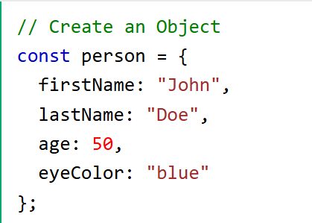
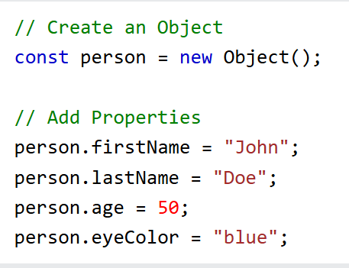
Objects
Objects are variables too. But objects can contain many values.

Slide 45
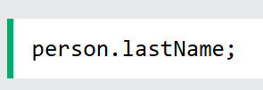
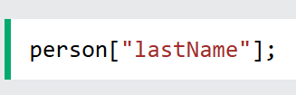
Object
You can access object properties in two ways:

Slide 46
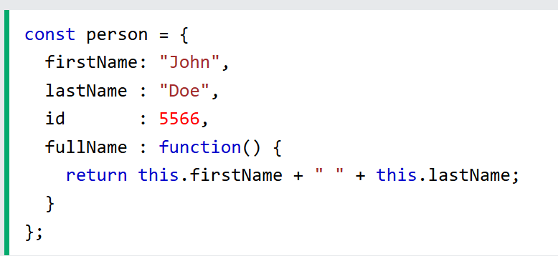

Object Methods
Methods are actions that can be performed on objects.

Slide 47


Object Methods
Adding method to object.
You can use javascript methods.

Slide 48
Display Object
Some solutions to display JavaScript objects are:
Displaying the Object Properties by name
Displaying the Object Properties in a Loop
Displaying the Object using Object.values()
Displaying the Object using JSON.stringify()

Slide 49

Display Object
Displaying the Object Properties by name.

Slide 50




Display Object
Displaying the Object Properties in a Loop
Note:
You must use person[x] in the loop.
person.x will not work (Because x is the loop variable).

Slide 51


Display Object
Displaying the Object using Object.values()
Object.values() creates an array from the property values:

Slide 52


Display Object
Displaying the Object using JSON.stringify()
JSON.stringify() method can convert an object to string
Included in JavaScript and supported in all major browsers.

Slide 53



Object constructor
Sometimes we need to create many objects of the same type.

Slide 54


Object constructor
Create objects with default values.

Slide 55


Event
HTML events are "things" that happen to HTML elements.
An HTML event can be something the browser does, or something a user does.
Here are some examples of HTML events:
An HTML web page has finished loading
An HTML input field was changed
An HTML button was clicked

Slide 56

Event
Common events:
W3Schools JavaScript Reference HTML DOM Events

Slide 57
Event
Event handlers can be used to handle and verify user input, user actions, and browser actions:
Things that should be done every time a page loads
Things that should be done when the page is closed
Action that should be performed when a user clicks a button
Content that should be verified when a user inputs data
And more ...
Many different methods can be used to let JavaScript work with events:
HTML event attributes can execute JavaScript code directly
HTML event attributes can call JavaScript functions
You can assign your own event handler functions to HTML elements
You can prevent events from being sent or being handled
And more ...

Slide 58






Array
An array is a special variable, which can hold more than one value:
Why use Arrays?
Creating Arrays?
Another ways:
Better for performance

Slide 59






Access Array elements
Array indexes start with 0
?
Changing an Array Element
Converting an Array to a String

Slide 60



Array are Objects
What value of person[2]?
?
Array are Objects

Slide 61






Array Properties, Methods
Adding array element

Slide 62


Basic array methods

Slide 63

Array search
indexOf()
array.indexOf(item, start)
- Array.indexOf() returns -1 if the item is not found.
If the item is present more than once, it returns the position of the first occurrence.
- Array.lastIndexOf() is the same as Array.indexOf(), but returns the position of the last occurrence of the specified element.the position of the first occurrence.
- Array.includes() to arrays. This allows us to check if an element is present in an array.
- Array.find() method returns the value of the first array element that passes a test function

Slide 64

Array Sort methods

Slide 65


Sorting an Array
The sort() method sorts an array alphabetically:
The reverse() method reverses the elements in an array:

Slide 66

Array Iteration

Slide 67




Array Interation

Slide 68




Dates

Slide 69

Date Get methods

Slide 70

Date Set methods

Slide 71

If else

Slide 72

Switch
Use the switch statement to select one of many code blocks to be executed

Slide 73


For Loop

Slide 74



Maps
A Map holds key-value pairs where the keys can be any datatype.
A Map remembers the original insertion order of the keys.
You can create a JavaScript Map by:
Passing an Array to new Map()
Create a Map and use Map.set()
Map.get()
Map.size
Map.delete()/ Map.clear()
Map.has()
Map.forEach()/ Map.entries()/ Map.key()s/ Map.values()

Slide 75



Class
Use the keyword class to create a class. Always add a method named constructor()
Class Methods

Slide 76

Class Inheritance
To create a class inheritance, use the extends keyword.
A class created with a class inheritance inherits all the methods from another class:
The super() method refers to the parent class.
By calling the super() method in the constructor method, we call the parent's constructor method and gets access to the parent's properties and methods.

Slide 77


Getters and Setters
Classes also allows you to use getters and setters.
To add getters and setters in the class, use the get and set keywords.
The name of the getter/setter method cannot be the same as the name of the property, in this case carname.

Slide 78

Class static
Static class methods are defined on the class itself.
You cannot call a static method on an object, only on an object class.

